Slide 1
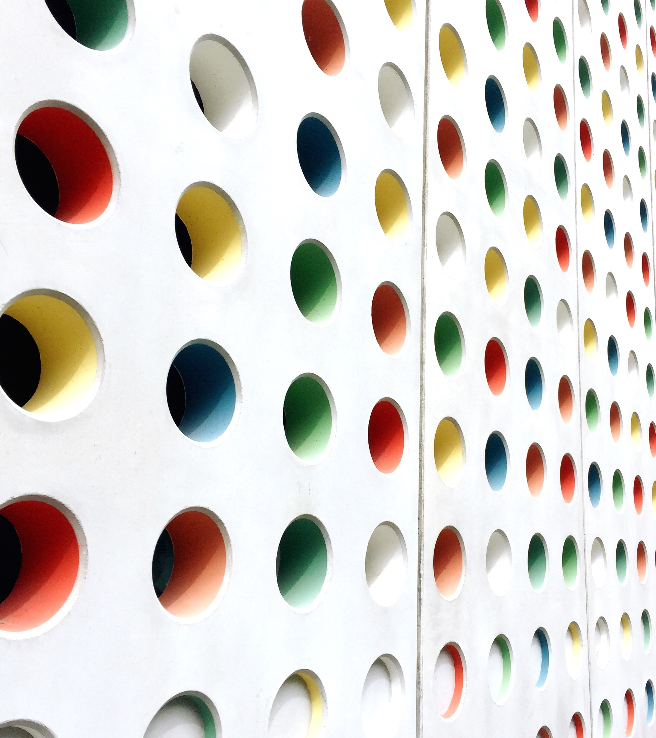
Color System
RGB
HSL
ABHRADEEP GUIN

Slide 2

RGB
HSL
CMYK
HSV
Types of Color Model

Slide 3
RGB Color Model
A color model is a structured method to generate a full spectrum of colors using a few primary ones. It converts colors into numerical values through mathematical formulas.
Red = #ff0000, Green = #00ff00, Blue = #0000ff

Slide 4
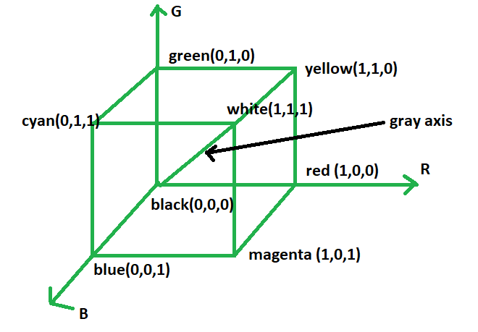
RGB Color Model
Each color is represented by its primary color components: Red, Green, and Blue.
This model is based on Cartesian Coordinate System.

Slide 5
RGB Color Model
Additive color model.
For computer displays.
Uses light to color display.
Colors result from transmitted light.
Red + Green + Blue = White.

Slide 6
Additive Color
Additive color is a method of creating color by mixing different wavelengths of light, typically red, green, and blue (RGB). It’s called “additive” because the more light you combine, the brighter the result becomes — and when all three primary colors are combined at full intensity, the result is white light. This model is used in digital displays, TVs, and projectors, where colors are formed by directly emitting light, not reflecting it.

Slide 7
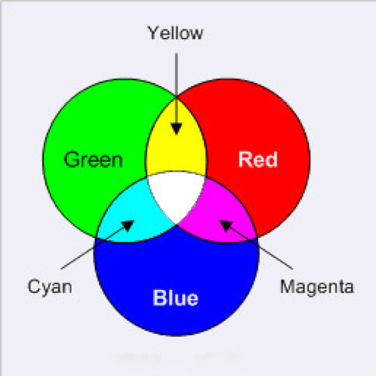
Example of Additive Color
This model is called additive, and the colors are called primary colors.
The primary colors can be added to produce the secondary colors of light- Magenta(Red + Blue), Cyan(Green + Blue), and Yellow(Red + Green). The combination of Red, Green and Blue at full intensities makes white.

Slide 8
HSL Color Model
HSL Stands for
Hue
Saturation
Lightness

Slide 9
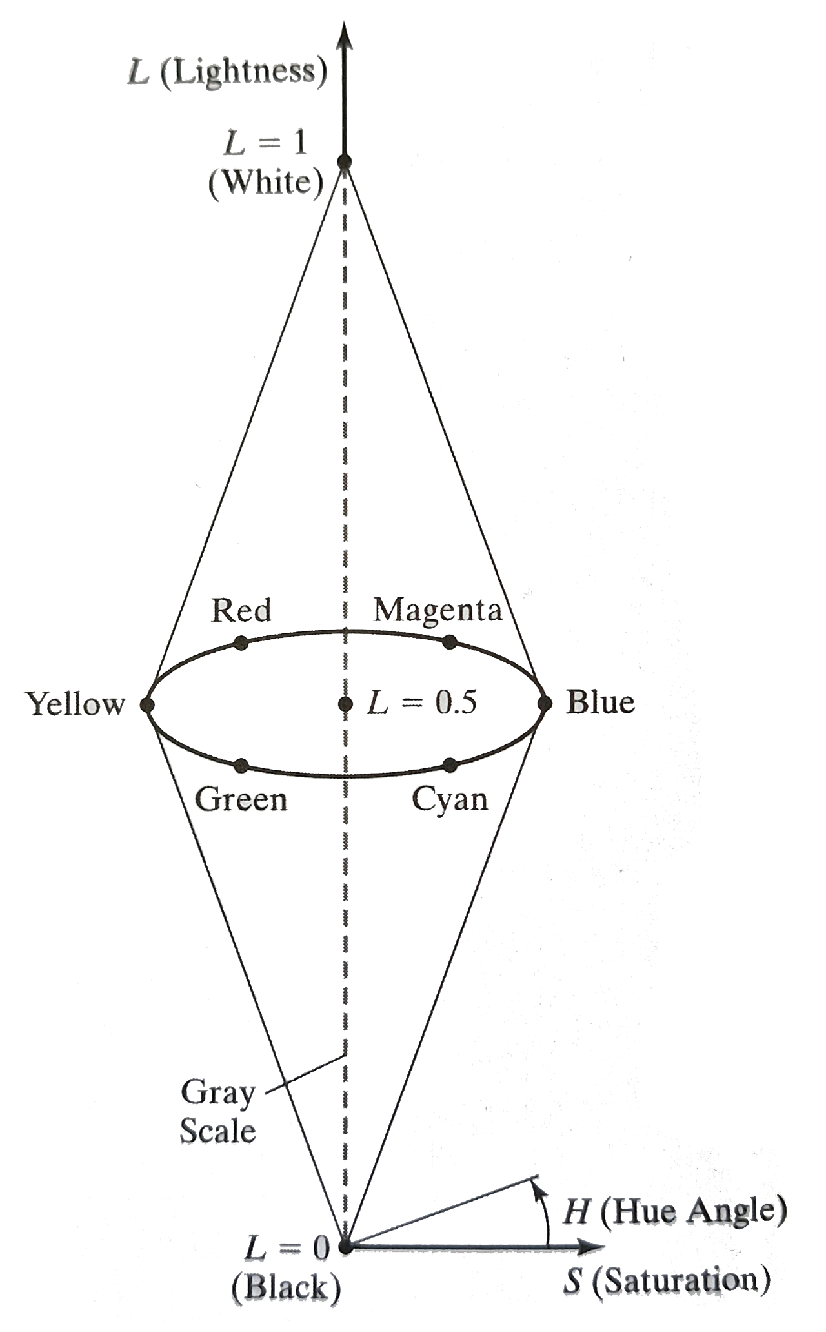
Hue
The angle around the central vertical axis corresponds to hue.
Saturation
The distance from the central axis corresponds to saturation.
0% - Grey & 100% - Full sat
Lightness
The distance along the central axis corresponds to lightness
0% - Black & 100% - White
Red = 0 = 360, Green = 120, Blue = 240

Slide 10
Advantages
East to understand color-wise
More intuitive that RGB
Great for adjusting brightness or tint
Helpful in design & theming
Disadvantages
Not widely supported in older tools
Can be harder to compute precisely
Less precise for real-world color mixing
Not device-dependent (can cause inconsistancies)

Slide 11
Bibliography
Computer graphics with OpenGL - Book by Donald Hearn and M. Pauline Baker
Google - https://google.com/
GeeksforGeeks - https://www.geeksforgeeks.org/
ChatGPT - https://chatgpt.com

Slide 12
Thank you
- Abhradeep

